Slide 1
Sutton Hoo Belt Buckle
By: Quinn Siegel and Abigail Scanlan

Slide 2
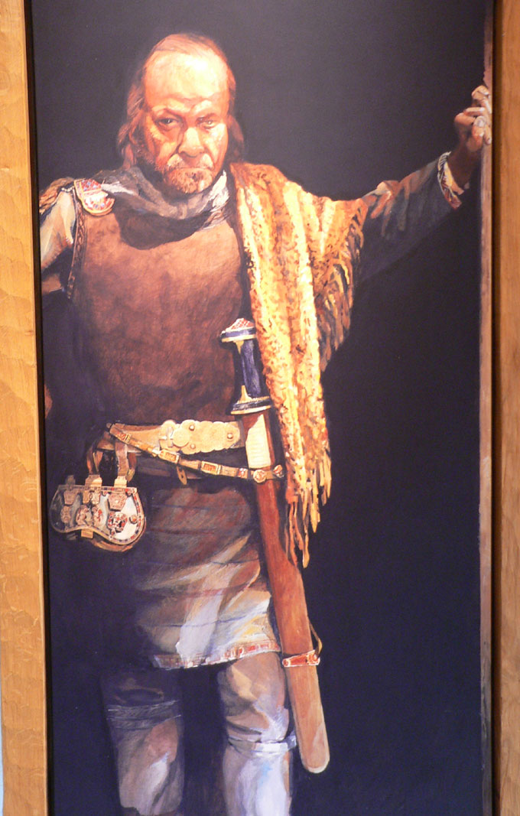
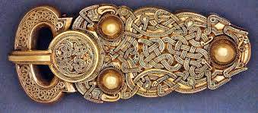
Who used it?
Raedwald, The ruler of East Anglia. He held senior power over England. Raedwald is not the for sure owner of the belt but most people believe he is. Some extra information about Raedwald is that he was a christian during his stay in certain cities, but he also followed the traditional Anglo-Saxon religions.

Slide 3
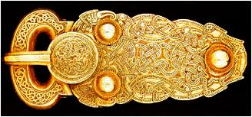
What is it?
It is a large belt buckle, that was buried in an undisturbed ship burial. It sheds light on a period of English history, and it is about 5.2 inches long.

Slide 4
When? Where?
WHEN-This came from the late 6th century or the early 7th century.
Where-Raedwald the so called owner of this came from the East angles in england.

Slide 5
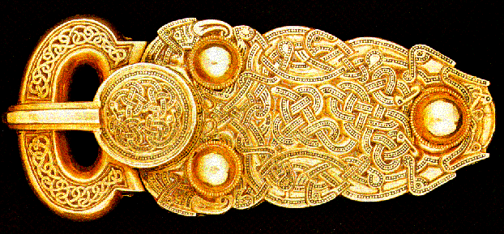
Why would it even exist ?
It existed because as a sign of authority or superiority they kings or rulers would be buried with expensive objects, such as bowls and plates.
Just like the majority or the Anglo-Saxon men he wore a belt, with a solid gold buckle. The craftsman who made it decorated it in a Germanic style , and even though it just looks like a random pattern it is supposedly two snakes twisted together , and if you look very closely you can see it.

Slide 6
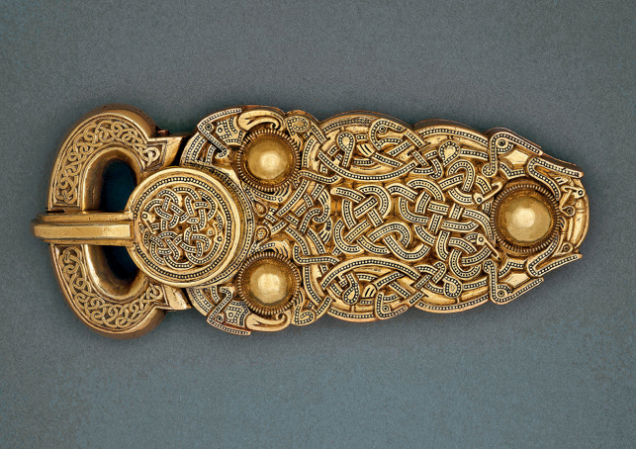
The discipline of this is art, specifically self-decor , or jewelry

Slide 7
Thank-you to google images for providing all of the images shown in the presentation.

